Slide 1
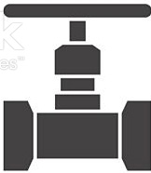
Automatic low-cost unpowered uniform NPC drip irrigation on a steep slope
How can identical NPC drippers at different levels have the same pressure?
upper dripper
The upper dripper must be open to the atmosphere as it discharges water into the vertical polypipe .
The valve is adjusted to prevent overflow at the upper dripper.
No overflow ensures that the flow rate of both the upper and lower dripper is the same.
The drippers are identical, and therefore the pressure at both drippers must also be the same.
water
supply
valve
water level
lower dripper

Slide 2
Increase the number of drippers
Replace the lower dripper with multiple identical drippers at the same level.
Replace the upper dripper with the same number of identical drippers inside a dripper assembly that discharges water into the vertical polypipe so that all drippers outlets are open to the atmosphere.
The flow rate and pressure at all drippers must be the same.
dripper assembly

Slide 3
dripper assembly 1
level 0
Increase the number of levels
dripper assembly 7
level 1
All drippers on all levels must have the same flow rate and the same pressure
level 7

Slide 4
Can we reduce the cost of the irrigation system by replacing the upper drippers with a smaller number of high-flow drippers?
Assume the upper and lower drippers are 2 L/H (eg Netafim button dripper red).
Assume the high-flow drippers are 8 L/H (eg Netafim button dripper green).
Replace each group of 4, 8, or 16 upper drippers with a high-flow dripper.
All of the lower drippers at all levels have the same flow rate and pressure.
The pressure at the lower drippers is the same, 1/4 , or 1/16 of the pressure at the upper drippers.

Slide 5
The irrigation can be automated with an Unpowered Terracotta Valve
control dripper
terracotta pot
No solenoid valves
No conventional irrigation controller
No wires
No hose clamps (low pressure)
No high pressure pump

Slide 6
dripper assembly 1
The valve can be adjusted so that water is almost overflowing at dripper assembly 1
The seven levels can be on a very steep slope (even vertical). The lowest level can be 100 metres or more below the highest level.
Provided there is no overflow at dripper assembly 1, every lower dripper on all levels will discharge the same amount of water

Slide 7
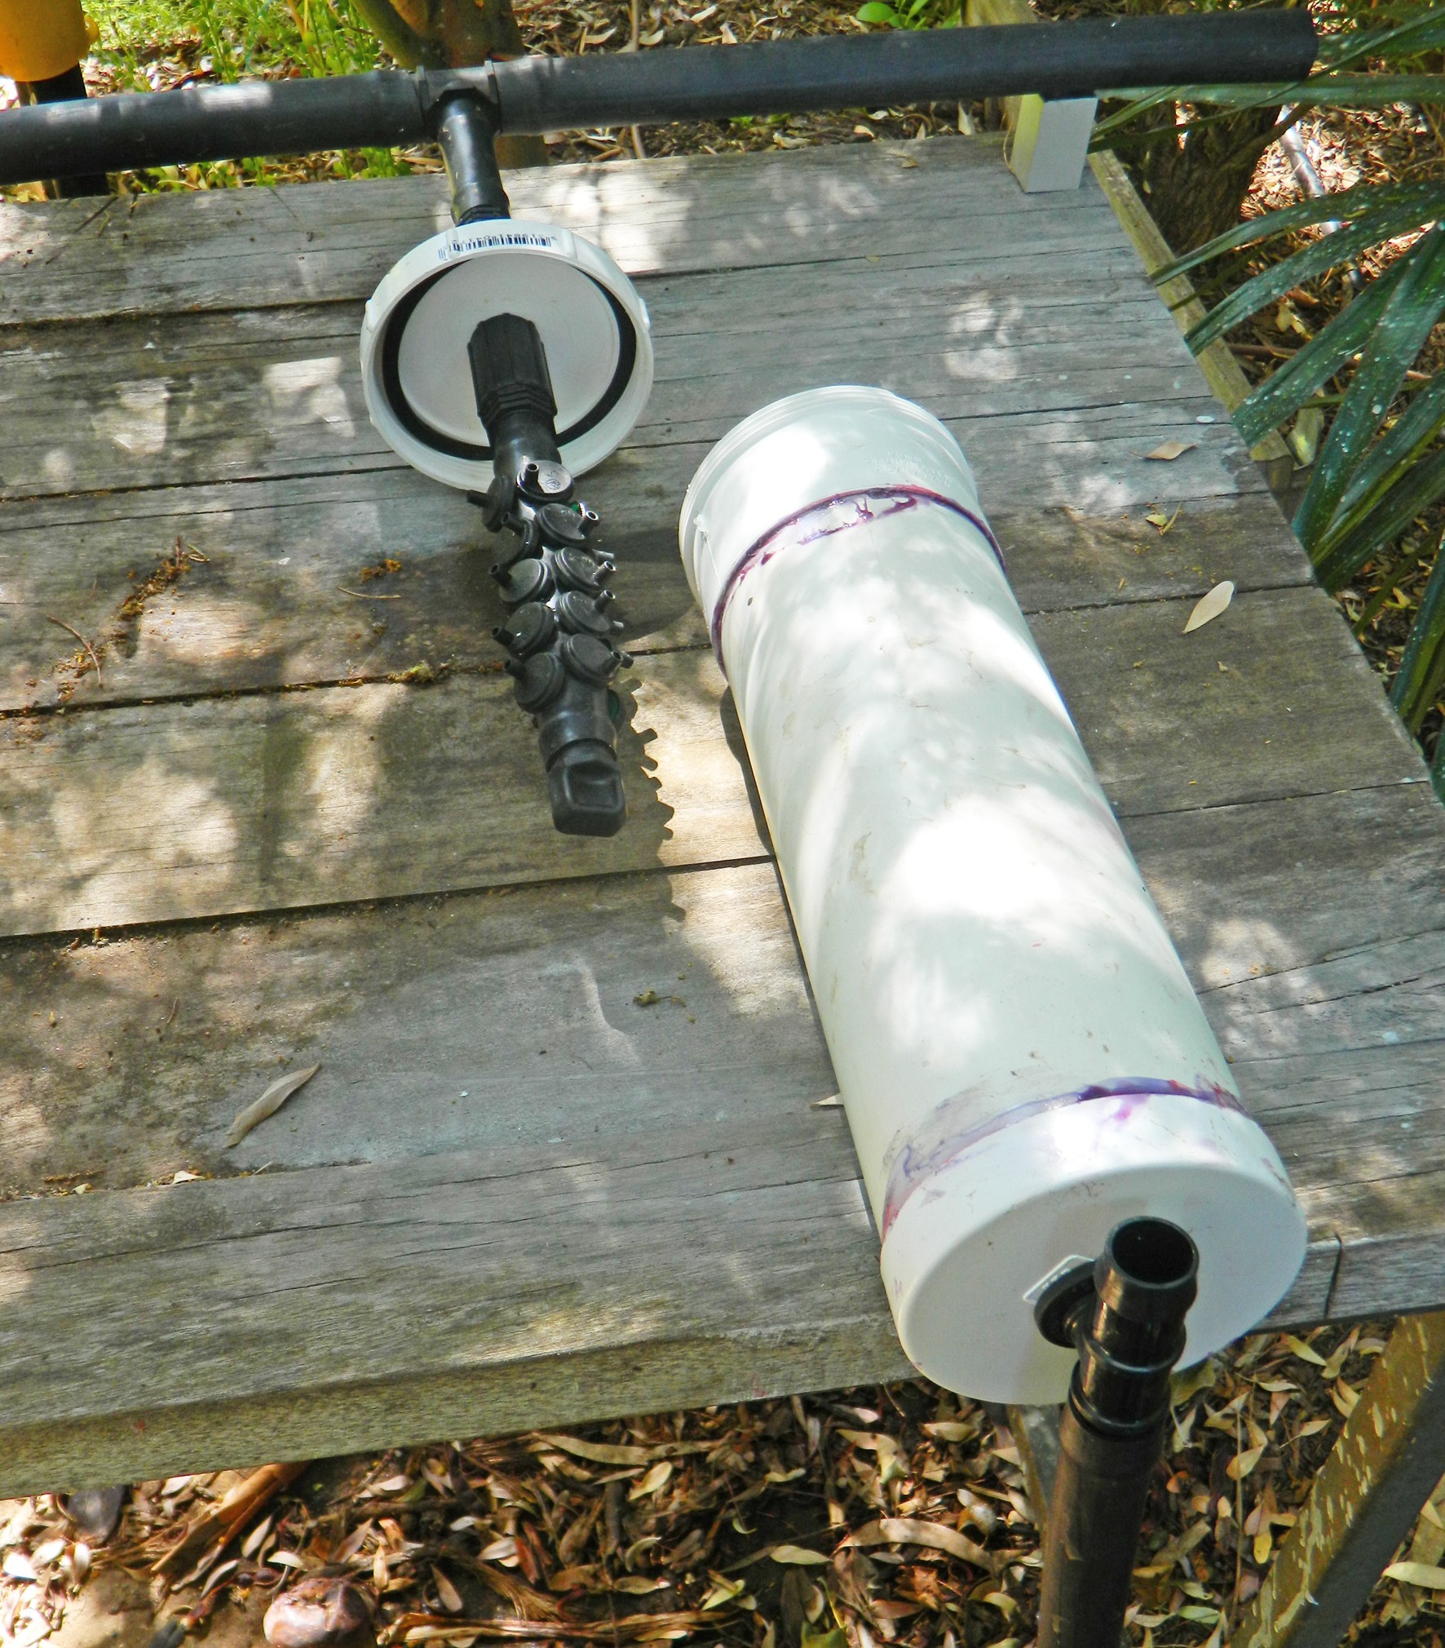
Unpowered Terracotta Valve
Dripper Assembly

Slide 8
Key features of the Omodei method:
The irrigation system is completely unpowered.
Easy installation and a fraction of the cost of an equivalent PC system.
All irrigation drippers discharge the same amount of water during the irrigation event.
Provided that all drippers (including the control dripper) have the same emitter discharge exponent, the water discharged by each dripper is independent of pressure.
Low emitter drainage at the end of the irrigation event is not a problem.
NPC dripline may be used instead of NPC drippers .
You can adjust the water usage rate by adjusting the control dripper.
You can adjust the interval between irrigation events by adjusting the float.
The irrigation system responds automatically to on-site evaporation and rainfall.
Simple, unpowered, and low tech, and therefore fewer things can go wrong.
You can leave your irrigation application unattended for weeks on end.

Slide 9
The irrigation method described is referred to as the Omodei method
Documentation can be downloaded from the website
www.measuredirrigation.com.au.
bomodei@measuredirrigation.com.au

